Slide 1


Getting Published
September 2013
Chris Brewster
Professor of International Human Resource Management
Henley Business School, Reading , UK; Radboud University, Nijmegen, NL; Vaasa University , FN

Slide 2
Introduction
Me: name, position/ area of interest, current projects, objectives
You: name, position/ area of interest, current projects, objectives
Potential programme
Working style

Slide 3
Potential programme (i)
Day 1 Welcome; introductions
Getting published: the (not very secret) secrets
Establishing a publishing strategy
Establishing your strategy
Shaping your article
Writing your article
            abstract
            introductions
            theory
            methodology
            Findings
            discussion/ conclusions

Slide 4
Potential programme (ii)
Day 2 Review of Day 1
Submission/ Managing the process
Responding to Reviewers/ Resubmitting
And again…
Publication!
Your next steps

Slide 5
The first session
  Getting published: the (not very secret) secrets
  Establishing a publishing strategy
  Establishing your strategy
  Shaping your article
  Who gets published?

Slide 6
The (not very) secrets
IF you have something to say, the rest is just technique:
Read the journals;
Use all levels of journal - try the easier ones first;
        or
        - start at the top for good reviews
Do as they tell you;
Practice;
Ask for help; (friends; academics; experts)
Be brave/ Learn

Slide 7
A strategic approach
  Establishing a publishing strategy
    why?
    what?
    when?
    where?
    who?
    how? That’s the trick…
  Establishing your strategy
    Next…

Slide 8
why publish?
good research should not be a secret
good practice; good test
credibility (doctorate/ career)
profile for your institution
contacts
…and it’s fun

Slide 9
What to publish?
Editors generally look for something that is:
  fresh (new topic; new location; new debate);
    (but note “following a thread”)
  committed (an argument);
  readable;
  coherent;
  fits their style/ uses their journal

Slide 10
When to publish
When you have something to say….
  A new summary of what is known (review)
  New information (most journals; practitioner and general press)
  A new methodology (specialist journal)
  A new analysis or contribution to theory (top journals)

Slide 11
Where to publish?
TOP journals
Middle-ranking journals
Practitioner journals, etc
Advantages and disadvantages of each?
Strategy and Priorities

Slide 12
Targeting the Journal
Subject area, aims and scope of journal
Has journal had papers on this topic?
Style of journal
  Quantitative vs Qualitative
  Theory vs Empirical vs Applied
Level of journal
  See listings of journal quality
  Your view on quality of paper
  “If you are not getting rejected, you are aiming too low” Donald Siegel [Editor JTT, Assoc Ed, JBV]

Slide 13
Which are Top Journals?
How defined?
  Subjective/ Local assessments
  ISI Journal Impact Scores ABS List
  Publish or Perish
  www.harzing.com
Citations
  Google scholar – usually much higher as pick up cites in other outlets than journals

Slide 14
TOP management academic journals
(that publish OB/HRM texts) Examples
Academy of Management Journal
Academy of Management Review
Administrative Science Quarterly
Organization Science
Journal of International Business Studies
Human Resource Management
Journal of Occupational Psychology
Organization Studies
Journal of Organization Behaviour
Journal of Management
Human Relations
International Journal of HRM
Management and Organization Review
Journal of Management Inquiry
’A’
’A-/B+’
’B(+)’

Slide 15
Publishing in the TOP journals
  target the manuscript: references, writing style and formalities & language (use language editor!)
  the introduction and the concluding discussions are very important ==> what did it tell us? so what? What’s new? where should we go from here?
  a good paper is extremely disciplined: what’s the argument? don’t jump around; tell a story (models?) and stick to it; work on the structure
  discuss your procedures, but don’t give them a stick to beat you with…
  don’t be amateurish: using straw men, overly negative view of the literature, use of underlining or exclamation marks, exaggerations
  cite own work rarely: only that in established outlets (and then only key ones)

Slide 16
What reviewers in the TOP journals look for…
Overall criteria: Significance of the (potential) contribution
  challenge to accepted wisdom in the field
  contribution to theory development
  contribution to empirical base
  contribution to practice
Adequate review of the existing literature?
Adequate research design?
Appropriateness of analytical procedures?
Insightful Discussion section?
Implications - so what?
Limitations?
Writing craft?

Slide 17
Who to write with
Why share the glory?
Why share the work?
Someone more or less experienced?
Where from?
What skills do they bring?
How similar are your views?
How well can you work together?

Slide 18
Rules of the game
Publish or perish
There is a home for every decent manuscript
Target every manuscript to a specific outlet (which journal? book chapter?)
You want to be read, not just published
Play to your strengths
Well-written manuscripts are in the minority
Argumentation is the key. Rhetoric matters
Grow a thick skin. It is all personal but you can’t take it personally
  keep improving
Just do it!

Slide 19
A publications strategy
Work on your own: write down your own publications strategy
then explain your strategy to your team: listen to and ask questions about your colleague(s) publications strategy.

Slide 20
Drafting your article

Slide 21
            Abstract
What should go into the Abstract?
Key words
Acknowledgements

Slide 22
            Introduction
What should go into the Introduction?
What’s the Novel [Theoretical and/or Empirical] Contribution?
“That’s Interesting” (Davis, 1971)
  Disconfirm some of existing assumptions
  Addressing observed puzzles
AMJ survey (Bartunek, et al. 2006)
  A paper is most interesting if is counter-intuitive
  Quality of research and Importance of research question

Slide 23
Introduction (ii)
What’s the research gap & why important to fill?
Consensus-challenging research vs ‘filling-in-the-potholes’
  Seeking to bring a new theoretical lens to an established area
    important to demonstrate the shortcomings of existing approaches and how the new lens causes us to see a topic quite differently: but
    Remember reviewers…
  Opening up a new topic not addressed before.
    Harder to publish in ‘top’ (more prestigious) journals until its validity has been established
    (If you can) avoid saying paper is exploratory
Be explicit about research question [and how you arrive at it]; about your contribution[s] to general [theory]; to specific topic
Summarise format of the rest fo the paper

Slide 24
            Theory
What should go into the literature/ theory?
Literature and Theoretical Framework
  Focus the literature review on the issues to be covered
  Clear and justified theory
  Integration of theories can be advantage but avoid too many
Hypothesis development
  Have an overall framework upfront so the reader knows how things fit together => Draw a diagram
  Use theory to develop hypotheses not previous empirical studies
  A few hypotheses: avoid replicative or boring hypotheses
  Hypotheses need to connect to the theoretical framework
    Can put others in control variables
Hypotheses & Propositions

Slide 25
            Methodology
What should go into the Methodology?
Data
  Sample and method
    Why this sample and method?
    Up to date data
  Cross-section vs longitudinal
    Endogeneity; causality vs association…
  Hand-collected vs off the shelf
  Differentiation; multiple sources..
  Multi-levels
  Mixed methods

Slide 26
Methodology (ii)
  Measures
    ‘quality’ of measures;
    derivation of research instrument;
    low response rates…
  Analytical tools
  Data preparation
    Response bias and representativeness tests
    Reliability, validity, common method bias, inter-rater reliability
    Variable definitions
      Connection between theory and measures
        Cf. ‘proxies’ in some disciplines
    Brief descriptives; correlation matrix, means and standard deviations, etc

Slide 27
            Findings
What should go into the Findings?
Results and Analysis
  Be concise and structure in line with Hypotheses
  Save Discussion for later
  Management journals tend to go for models with clearer justified measures, rather than use of different proxies
  Build up from controls to final model showing significance of incremental R²
  Top journals tend to frown on 10% sig. levels

Slide 28
            Discussion
What should go into the Discussion?
Discussion
  Summarize findings; Link results to literature – what is surprising? What is interesting? [don’t use that word!]
  Don’t go beyond your findings
  Implications for management
  Limitations and further research

Slide 29
Conclusions
Conclusions
  Emphasize contribution
  End with a coda - don’t finish on limitations!
References
Check journal style and completeness yet again; get your friends to do it.
Footnotes [avoid or minimize!]
Tables & Figures

Slide 30
Your priority article
Outline your ‘priority article’
How will you turn your ‘priority article’ plans into a submission?
“10% inspiration; 90% perspiration”:
  Think strategically
  Do your homework
  Stick at it (mentor?)
What will you do next week? Next month? By January?
Work on your own: then share the results with your team

Slide 31
Paper Submitted
Send for Review
Reject
Revise and Resubmit
Reject
Repeat the process ….
Reject
Revise and resubmit
Accept
Reject
Publish

Slide 32
Sending off your script: check
Title reflects content (simple is good)
Readability
Length/ Words
Proper citations/ referencing
Physical presentation
Headings
References (style and number)
Tables and Figures

Slide 33
Sending off your script: practical
Do:
Read back copies of the Journal
Check the latest copy for requirements
Include a short covering letter “selling” your manuscript
Get an internal/ friend/ expert to review first
Don’t:
Submit and hope for the best
Submit if you can’t be bothered to meet the requirements
Remember:
Journals get thousands…

Slide 34
The Review Process
Editor
2/3 blind Reviews
  remember them when writing…
Editor’s Decision and letter
(3 months)
You can push…but it often does not help

Slide 35
Resubmitting
Say thank you! Be nice…
85%+ of work submitted to top journals is rejected!
All top authors have high rejection rates – if you don’t: you are not a top author…
sometimes frustrating but also interesting & rewarding:
revising your paper: “engage” with the Editor and Reviewers
  address explicitly all comments by the reviewers in a separate letter
  take all comments seriously and show appreciation
  be responsive: but you don’t have to accept everything!
  You do have to accept the editor’s comments!
  negotiate with the editor if necessary: new reviewers?
  revise and resubmit quickly (but not too quickly)

Slide 36
Publication!
And then…
Exploit it: Send it out. Network.
Do it all again….

Slide 37
A writing strategy
Work in (new) teams:
identify five good things to do when writing articles;
and five things to avoid.

Slide 38
Getting Published: a guide
Good Luck!
c.j.brewster@henley.ac.uk

Slide 39

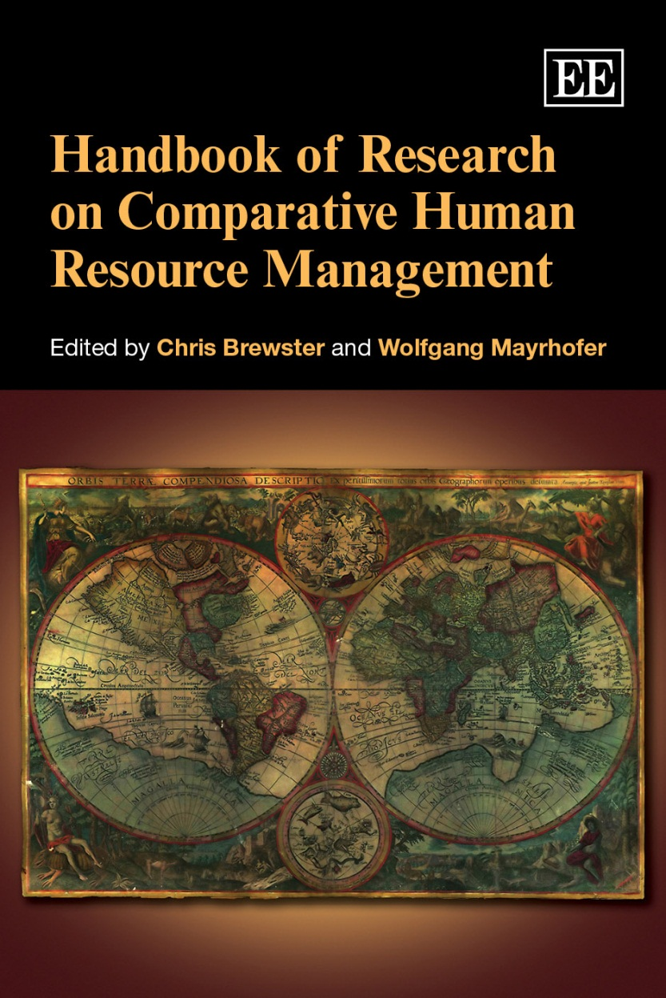

Slide 40
Example Publications (i)
Books:
Brewster, C. and Mayrhofer, W. (2012) A Handbook of Research on Comparative Human Resource Management, Cheltenham, Edward Elgar
Brewster, C., Carey, L., Dowling, P., Grobler, P., Holland, P. and Warnich, S. (2012) Contemporary Issues in Human Resource Management: Gaining a Competitive Advantage, (4th edition) Oxford University Press, South Africa, Cape Town
Brewster, C. Sparrow, P., Vernon. G. and Houldsworth, L. (2011) International Human Resource Management. (3rd edition), CIPD, Wimbledon
Brewster, C., Mayrhofer, W. and Morley, M., (eds) (2004) Human Resource Management in Europe: Evidence of Convergence? Butterworth Heinemann, London

Slide 41
Example Publications (ii)
Articles:
Goergen, M., Brewster,C., Wood, G.T. and Wilkinson, A ( 2012) Varieties of capitalism and investments in human capital Industrial Relations 51 (2): 501-527
Croucher, R., Wood, G., Brewster, C. and Brookes, M.(2012) Employee turnover, HRM and institutional contexts Economic and Industrial Democracy 33 (4) 605-620
Mayrhofer, W., Brewster, C., Morley, M. and Ledolter, J. (2011) Hearing a Different drummer? Evidence of convergence in European HRM Human Resource Management Review 21 (1): 50-67
Wood, G.T., Croucher, C., Brewster, C., Collings, G.C. and Brooks, M. (2009) Varieties of Firm: complementarity and bounded diversity. Journal of Economic Issues 43 (1): 241-260
Farndale, E., Brewster, C. and Poutsma, E. (2008) Coordinated vs. liberal market HRM: the impact of institutionalisation on multinational firms. International Journal of Human Resource Management 19 (11): 2004-2023
Brewster, C., Wood, G. and Brookes, M. (2008) Similarity, Isomorphism or Duality: recent survey evidence on the HRM policies of Multinational Corporations British Journal of Management 19 (4): 320-342
Brewster, C., Wood, G., Brookes, M. and van Ommeren, J. (2006) “What Determines the Size of the HR Function?: a cross-national analysis” Human Resource Management, 45(1):3-21
Brookes, M., Brewster, C. and Wood, G., (2005) “Social Relations, Firms And Societies: A Study Of Institutional Embeddedness” International Sociology, 20(4): 403-426

